Slide 1
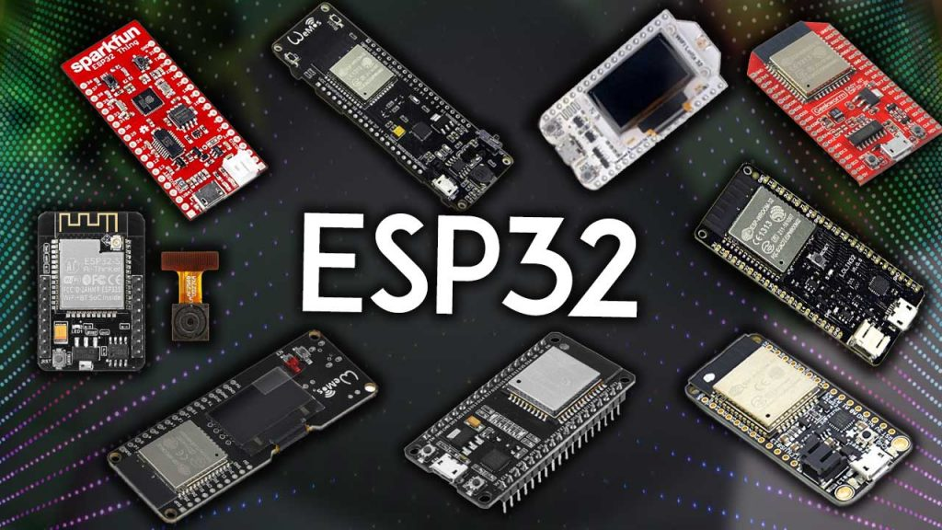
Introduction to ESP32
Hardware-Related Programming Environment

Slide 2
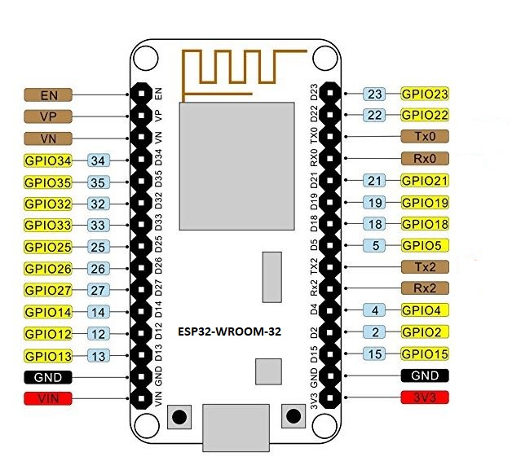
INTRODUCTION TO ESP32
The ESP32 is a powerful and versatile microcontroller developed by Espressif Systems. It stands out for its dual-core processor, built-in Wi-Fi and Bluetooth connectivity, low power consumption, and a rich set of peripherals.
Core Features
Dual-Core Processor
The ESP32 is equipped with two processor cores, providing the ability to execute multiple tasks simultaneously. This parallel processing capability significantly enhances the overall performance of the microcontroller.
Wi-Fi and Bluetooth Connectivity
One of the standout features of the ESP32 is its integrated Wi-Fi (802.11 b/g/n) and Bluetooth (Bluetooth Low Energy) capabilities. This makes it an excellent choice for applications that require wireless communication, such as Internet of Things (IoT) devices.

Slide 3
INTRODUCTION TO ESP32
Low Power Consumption
The ESP32 is designed for optimized power usage, making it suitable for applications where energy efficiency is crucial. This feature is particularly beneficial for battery-powered devices, ensuring an extended operational life.
Rich Peripheral Set
The microcontroller offers a comprehensive set of peripherals, including GPIO, UART, I2C, SPI, ADC, and more. This versatility provides developers with the flexibility to interface with a wide range of sensors, actuators, and other external components.
Security Features
Security is a priority in the ESP32, with features like secure boot and flash encryption. These measures ensure data integrity and protect against unauthorized access, making the microcontroller suitable for applications with stringent security requirements.

Slide 4
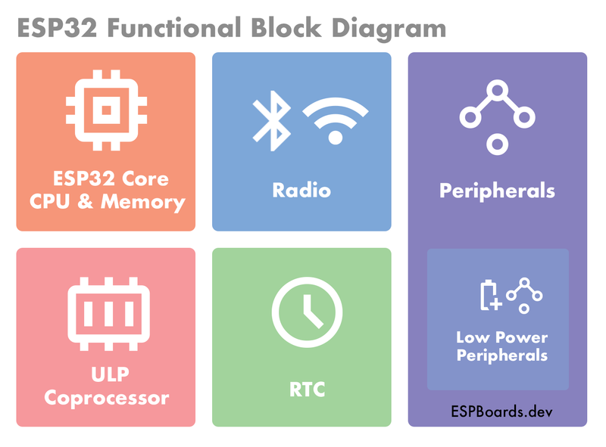
ESP32 Functional Block

Slide 5
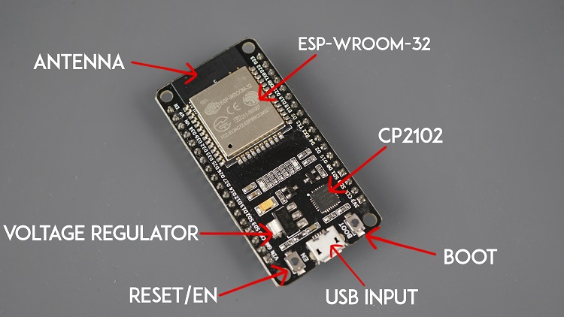
FEATURES
ADVANCED ANALOG FEATURES
The ESP32 boasts a 12-bit Analog-to-Digital Converter (ADC) for precise analog signal measurements. This is particularly useful in applications where accurate analog data acquisition is essential.
APPLICATION SCENARIOS
IoT Devices
The ESP32 is well-suited for IoT applications, connecting devices to the internet and enabling seamless data exchange and remote control.
Home Automation
Its capabilities make the ESP32 an ideal choice for smart home systems, allowing control of appliances, monitoring environmental parameters, and facilitating automation.
Wearables
With its low power consumption and compact size, the ESP32 is suitable for wearables such as fitness trackers and smartwatches.

Slide 6
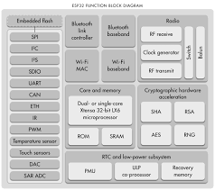
FEATURES
INDUSTRIAL AUTOMATION
In industrial settings, the ESP32 can be employed for automation and control tasks, leveraging its connectivity and processing capabilities.
Robotics
The dual-core processing and diverse peripherals make the ESP32 suitable for robotics applications, handling complex tasks efficiently.
DETAILED HARDWARE COMPONENTS
Processor Architecture
The ESP32 features a dual-core Tensilica LX6 microprocessor, providing the computational power necessary for diverse applications.
Memory
With integrated 520 KB SRAM and support for external SPI flash and PSRAM, the ESP32 offers ample storage for program code and variable data.
Connectivity
Wi-Fi (802.11 b/g/n) and Bluetooth (Bluetooth Low Energy) capabilities enable wireless communication, ensuring seamless device connectivity.

Slide 7
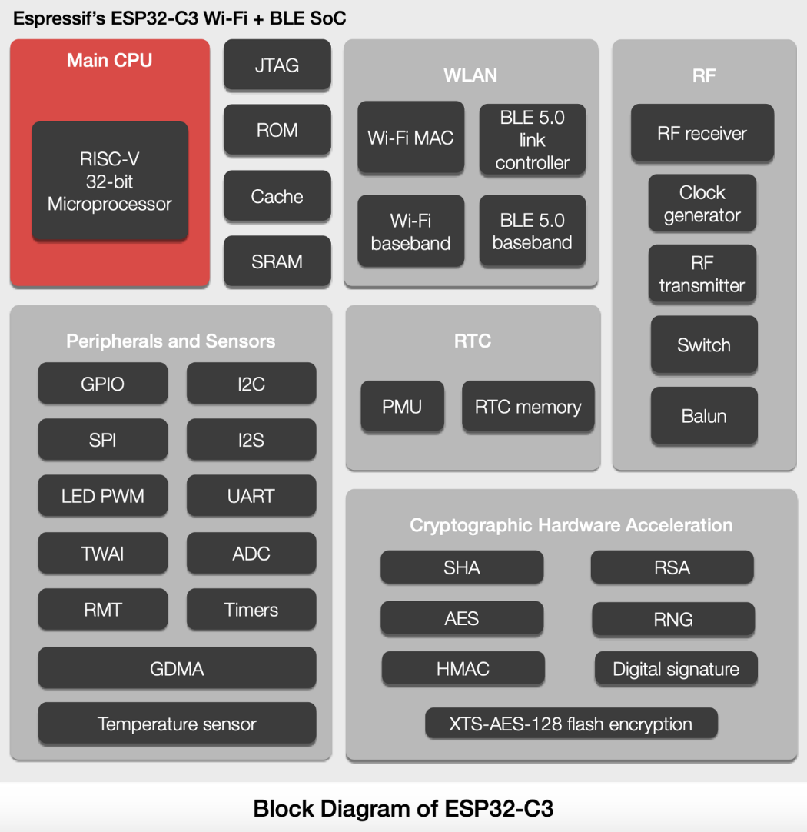
Features
POWER MANAGEMENT
Support for multiple power modes allows the ESP32 to optimize energy usage, making it suitable for battery-powered applications.
PERIPHERALS
A rich set of peripherals including GPIO, UART, I2C, SPI, I2S, PWM, ADC, DAC, and more provide the flexibility to interface with various external components.
Security Components
Secure boot, flash encryption, and cryptographic hardware acceleration contribute to robust security, protecting against unauthorized access and tampering.

Slide 8
Features
Analog Components
A 12-bit SAR ADC with up to 18 channels supports high-precision analog-to-digital conversion, enabling accurate sensor readings.
External Interfaces
Support for interfaces like SD/MMC, CAN, Ethernet MAC, and others expands the range of peripherals that can be connected to the ESP32.

Slide 9
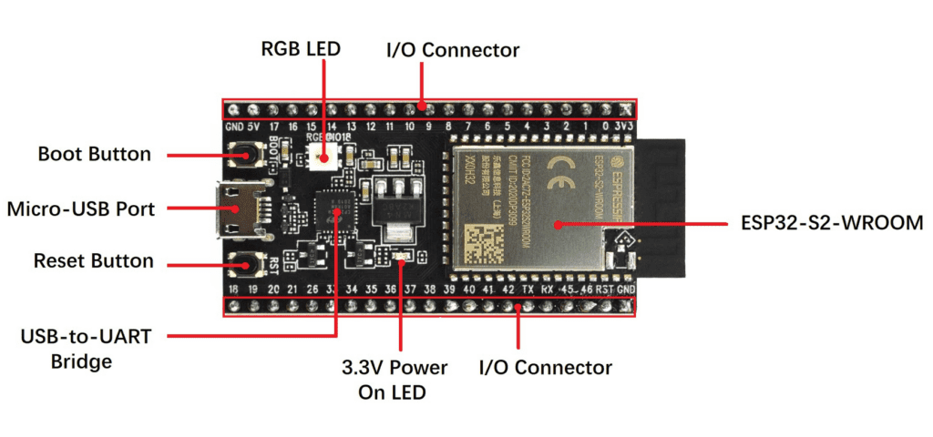
Outline
Development Guidelines
Modules and Development Boards
Espressif offers various ESP32 modules and development boards, allowing developers to choose the form factor that best suits their project requirements.
Programming and Firmware
Guidelines for downloading firmware and programming the ESP32 are crucial for ensuring a smooth development process and proper functionality of the microcontroller.
Resources and Documentation
Access to datasheets, technical reference manuals, development tools, and community support provides developers with the necessary resources for in-depth knowledge and issue resolution during the development process.

Slide 10
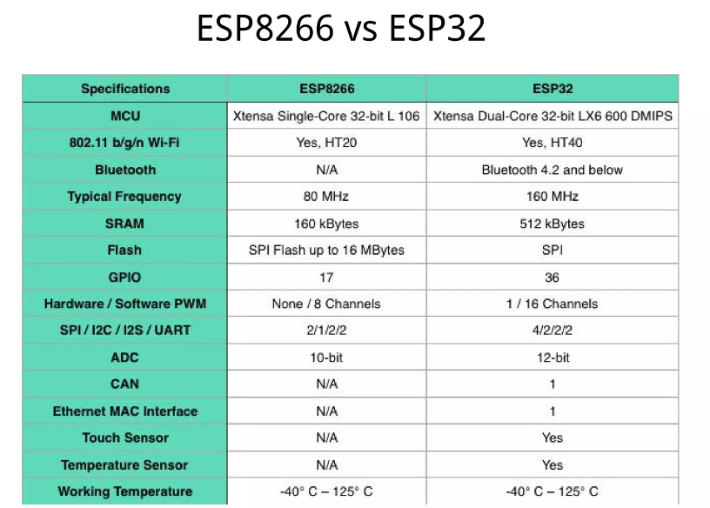
ESP8266 Vs ESP32

Slide 11
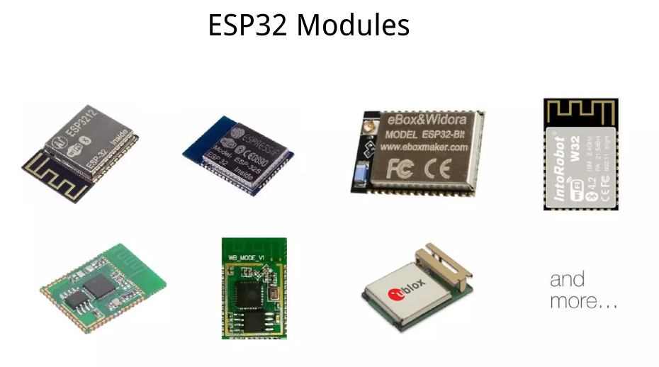
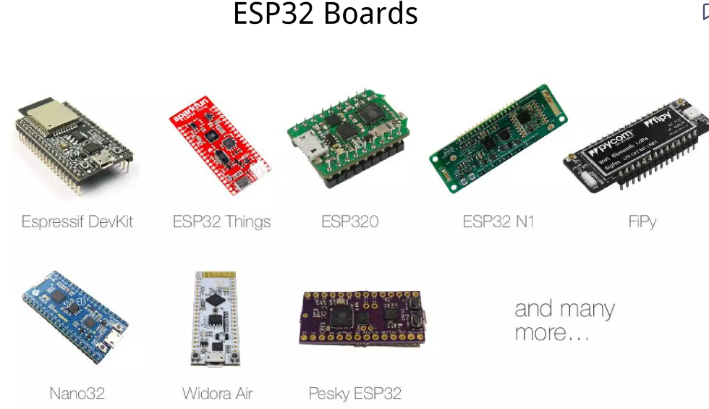
ESP32 Board

Slide 12
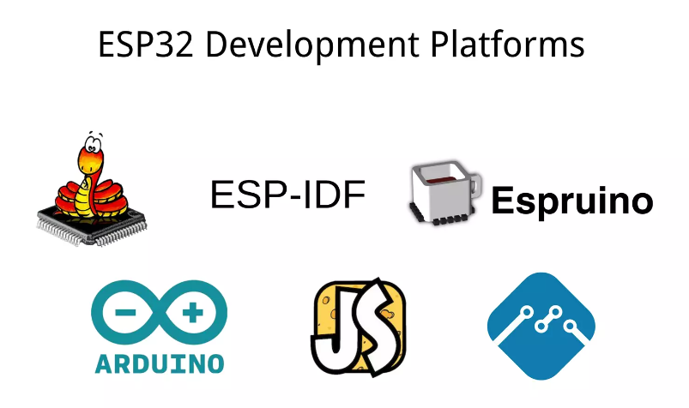
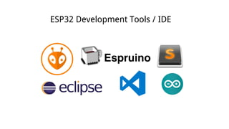
ESP32 Development Platform

Slide 13
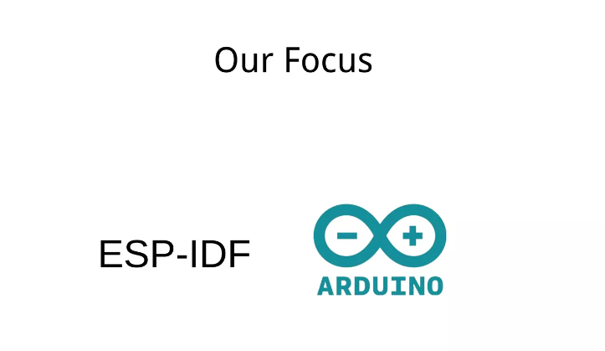
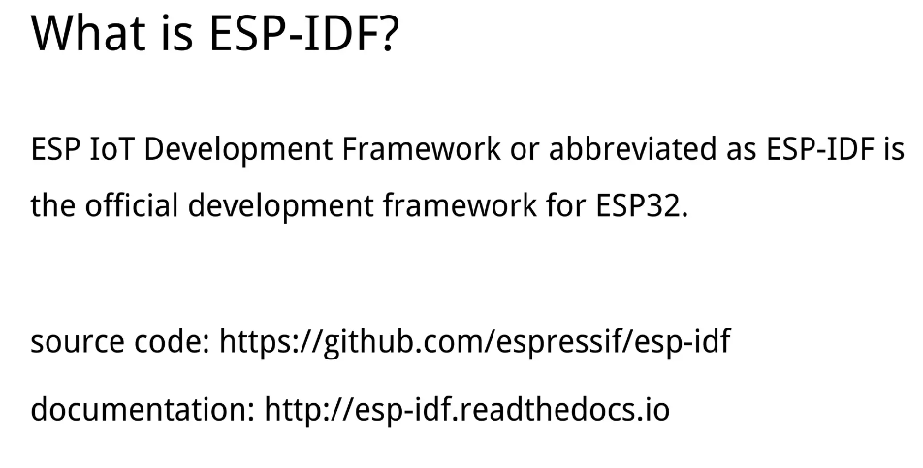
ESP-IDF Arduino

Slide 14
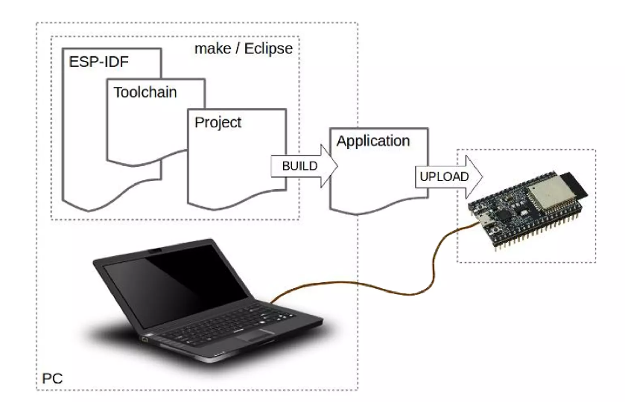
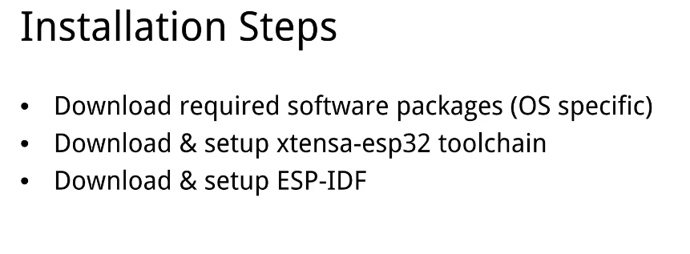
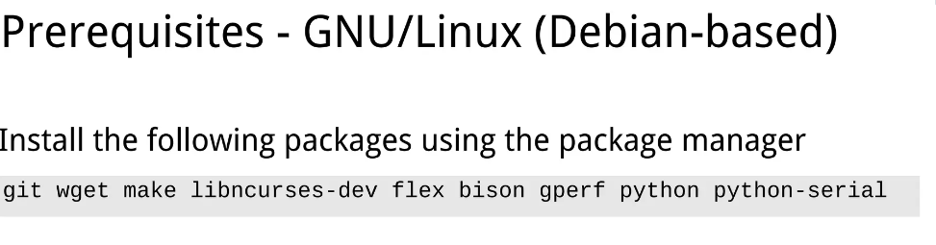
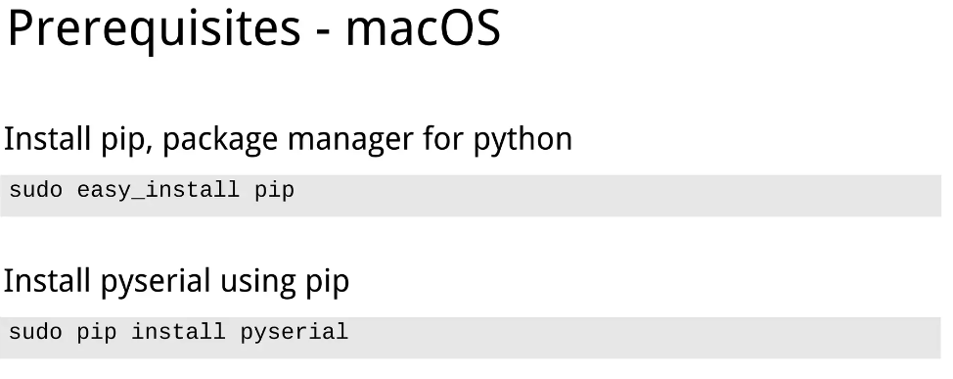
Installation Steps

Slide 15
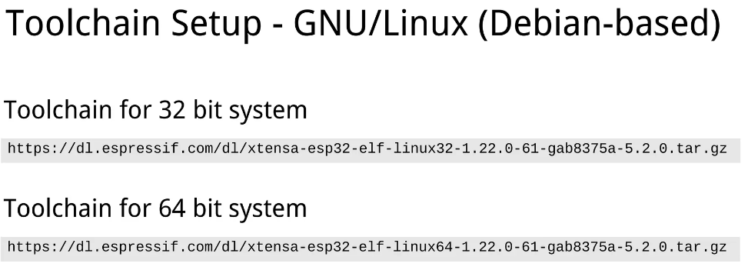
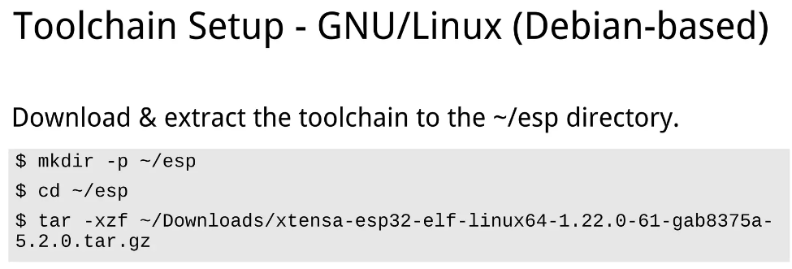
Toolchain setup

Slide 16
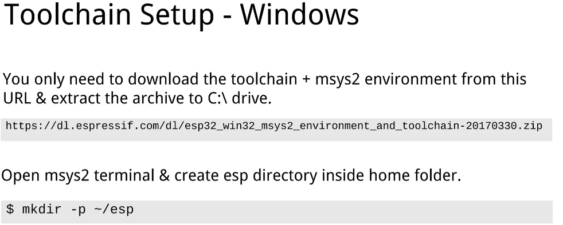
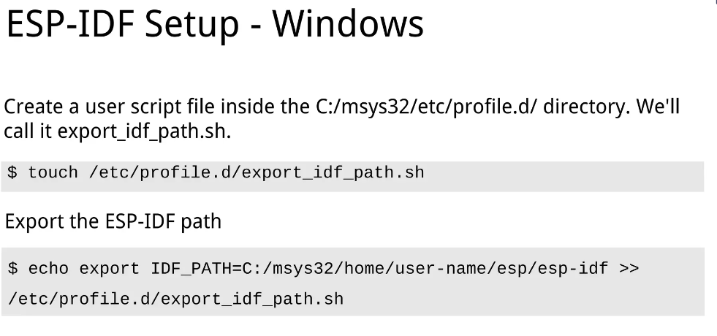
Toolchain setup windows

Slide 17
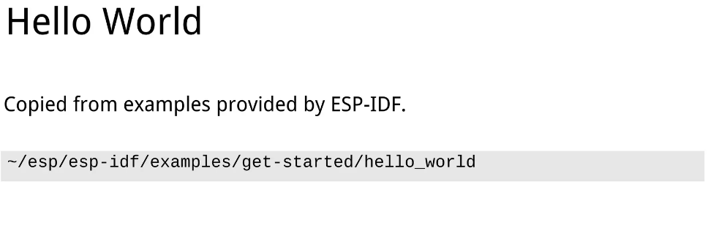
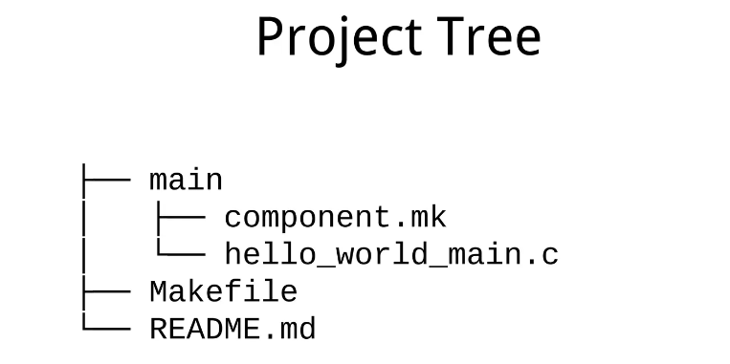
ESP-IDF Example

Slide 18
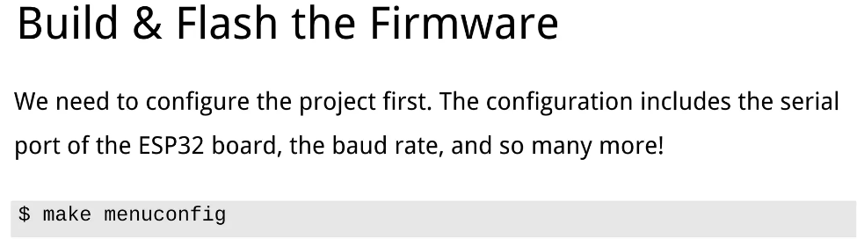

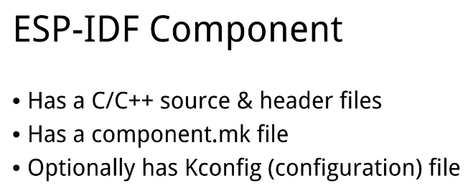
ESP-IDF Component

Slide 19
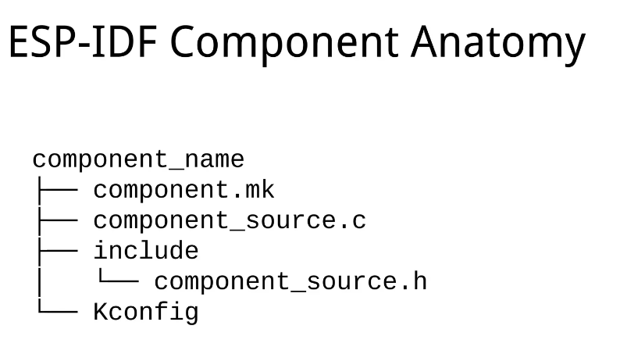

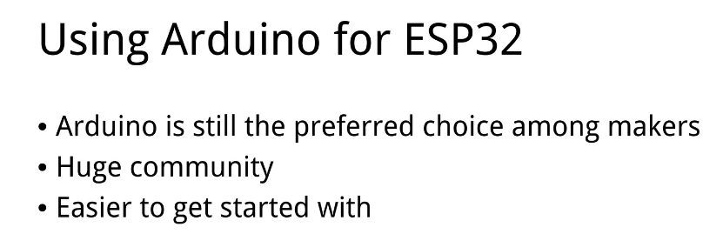
ESP-IDF

Slide 20

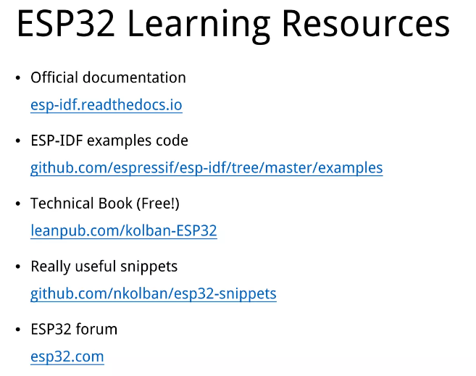

Slide 21
Thank You..

